Slide 1


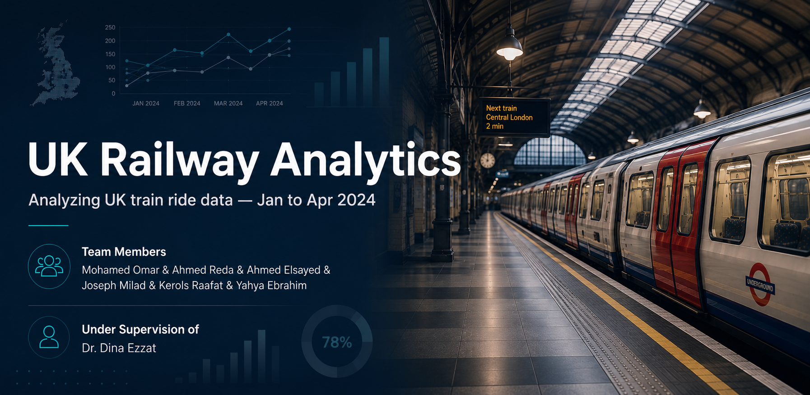

Slide 2

Business Problem
UK train operators are losing revenue and customer trust and the data tells us exactly why.
Problem | Evidence
Operational disruption | 7.24% delay rate + 5.94% cancellation rate
Revenue volatility | Revenue dropped 20% from Jan (£199,618) to Feb (£159,374)
Revenue volatility | £38,702 in refunds out of £741,921 gross revenue

Slide 3
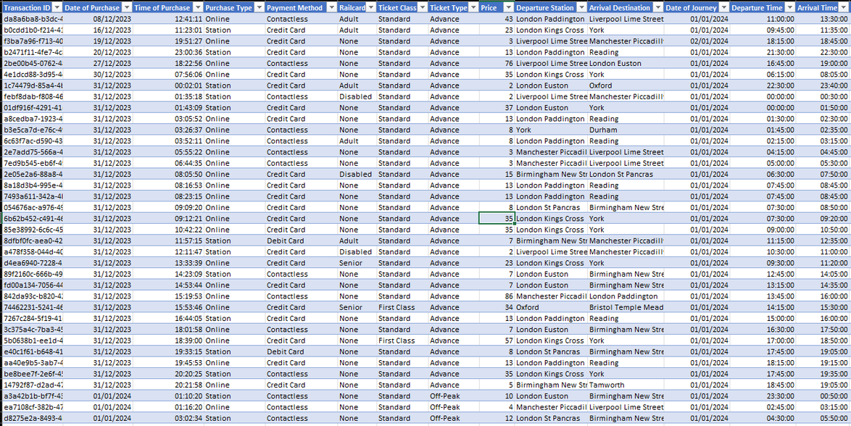
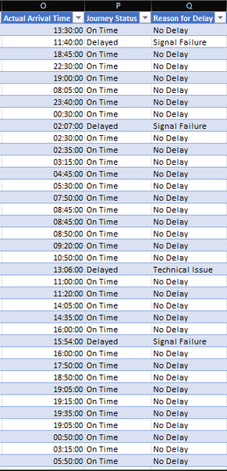
Dataset
The dataset includes 31,653 railway journeys from January to April 2024, covering operational, financial, and customer-related data to support performance analysis and forecasting.

Slide 4
Objectives
Analyze monthly revenue trends and identify peak and low-performing periods.
Evaluate operational performance by analyzing delays and cancellations.
Identify the key drivers of revenue and refund requests.
Understand customer behavior across ticket types and Railcards.
Analyze customer booking behavior to identify peak ticket purchasing times.
Forecast future railway demand to support data-driven planning

Slide 5


Data Cleaning
1) Validate Railcard Values
Verified that "None" represents passengers without a Railcard, so it was kept as a valid category during data preparation.

Slide 6
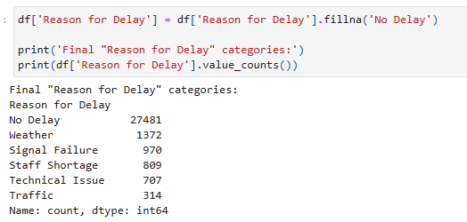
Data Cleaning
2) Fill Missing Delay Reasons
27,481 missing values (86.82%) were found in Reason for Delay.
These records correspond to On Time journeys, so replacing them with "No Delay" preserved meaningful information.

Slide 7

Data Cleaning
3) Validate Actual Arrival Time
1,880 missing values (5.94%) were found in Actual Arrival Time.
Validation confirmed they all belonged to Cancelled journeys, so the missing values were kept as NaN because no arrival actually occurred.

Slide 8
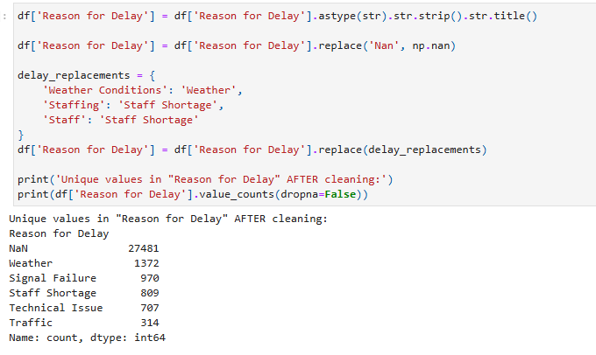
Data Cleaning
4) Standardize Delay Reasons
Delay reason names were inconsistent.
Categories were standardized to improve grouping accuracy and ensure reliable analysis

Slide 9
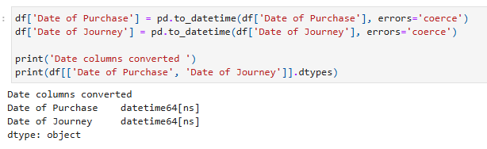
Data Cleaning
5) Convert Data Types
Date columns were converted to datetime and Price to integer.
This enabled accurate time-based analysis and calculations.

Slide 10
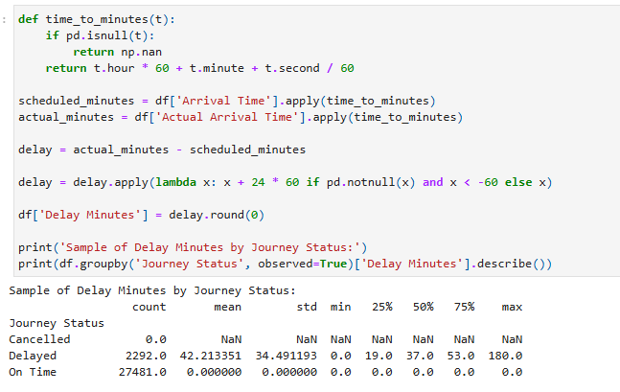
Feature Engineering
1) Delay Minutes
Created a new feature to calculate the delay duration in minutes.
Avg delay: 42.2 min — worst route: Manchester Piccadilly → Leeds at 143.7 min avg.

Slide 11
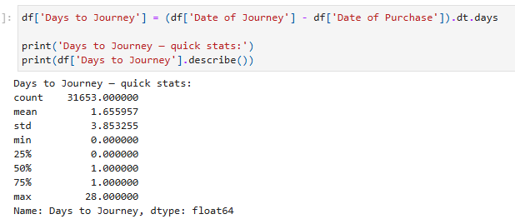
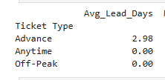
Feature Engineering
2) Days to Journey
Calculated the number of days between booking and travel.
Overall avg: 1.65 days — Advance tickets booked 2.98 days ahead vs. 0 days for Anytime/Off-Peak, explaining the price gap.

Slide 12
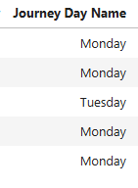
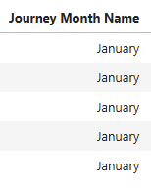
Feature Engineering
3) Journey Day Name
Extracted the day of the week for each journey.
Used to compare operational performance across weekdays.
4) Journey Day Name
Created a month name feature from the journey date.
Used to analyze monthly trends in revenue and journey volume.

Slide 13
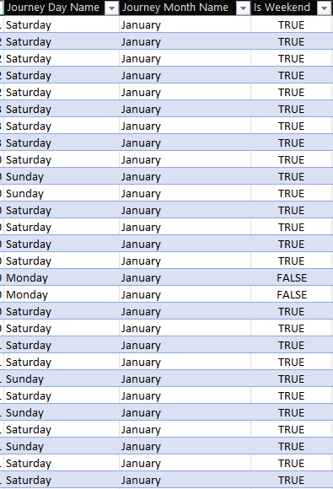
Feature Engineering
5) Is Weekend
Created a Boolean feature to identify weekend journeys.
Used to compare weekday and weekend travel patterns..

Slide 14
KPIs
Before we dive into the analysis, here are the 8 KPIs that define the health of the railway network across January to April 2024.
KPI | Gross Revenue | Total Passengers | Avg Ticket Price | Net Revenue
VALUE | £741,921 | 31,653 | £23.44 | £703,219
KPI | On-Time Rate | Cancellation Rate | Total Refunded | Delay Rate
VALUE | 86.82% | 5.94% | £38,702 | 7.24%

Slide 15
Overview
Revenue Performance & Customer Segments
1) Revenue Volatility — Monthly Trend
Revenue had no clear growth trend. January was the best month at £199,502, February dropped 20% to £159,334, March recovered, then April dipped again.
Month | Revenue | Change vs Previous
January | £199,502 | ـــــــــــ
February | £159,334 | ▼ −20.1%
March | £195,147 | ▲ +22.4%
April | £187,782 | ▼ −3.8%

Slide 16
Overview
Revenue Performance & Customer Segments
2) Who Really Drives Revenue?
Despite discount programs existing, 77.3% of revenue comes from full-fare passengers. Their avg ticket (£27.43) is 75% higher than Railcard holders (£15.67).
Railcard Type | Revenue | Share
None | £573,697 | 77.3%
Adult | £86,118 | 11.6%
Disabled | £52,278 | 7.0%
Senior | £29,616 | 4.0%

Slide 17
Overview
Revenue Performance & Customer Segments
3) Route Concentration Risk
London Kings Cross to York alone generates £183,193 — 24.7% of total revenue. The top 5 routes combined account for 64.1% of all revenue, meaning the business is heavily concentrated in a handful of routes.
Route | Revenue | Share
London Kings Cross → York | £183,193 | 24.7%
Liverpool Lime Street → London Euston | £113,299 | 15.3%
London Paddington → Reading | £65,368 | 8.8%

Slide 18
Overview
Revenue Performance & Customer Segments
4) Ticket Type Performance
Advance tickets generate the highest revenue (£309,200 = 41.7%) despite having the lowest average price (£17.61). Passengers book 2.98 days ahead on average — volume compensates for the lower price.
Ticket Type | Revenue | Avg Days Booked Ahead | AVg Price
Advance | £309,200 | 2.98 days | £17.61
Off-Peak | £223,200 | 0 days | £25.52
Anytime | £209,309 | 0 days | £39.20

Slide 19
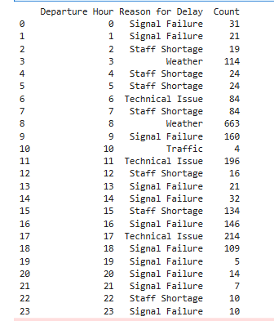
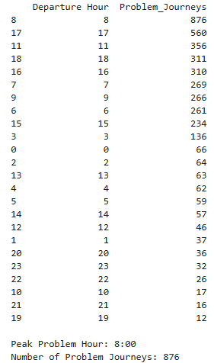
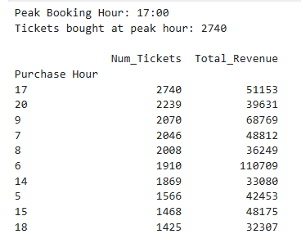
Overview
Revenue Performance & Customer Segments
5) When Do Customers Buy Tickets & Operational Issues?
The highest ticket booking activity occurs at 5:00 PM (17:00), with approximately 2,740 tickets purchased.
The highest number of operational issues occurs during the 8:00 AM departure hour, with 876 delayed or cancelled journeys.

Slide 20
Insights & Recommendations
1) Revenue is Volatile — No Clear Growth
Insight:
Revenue dropped 20% in February with no clear growth trend across 4 months.
Recommendations:
Investigate February demand drivers — consider promotional pricing or marketing campaigns in low-demand months.
2) Full-Fare Passengers Drive 77.3% of Revenue
Insight:
Despite Railcard discount programs, full-fare passengers generate £573,697 — paying 75% more per ticket than discount holders.
Recommendations:
IPrioritize full-fare passenger experience — on-time performance, comfort, and service quality directly impact the company's primary revenue source.

Slide 21
Insights & Recommendations
3) Customer Demand and Operational Pressure Peak at Different Times
Insight:
Customer demand peaks in the evening (5:00 PM), while operational issues peak during the morning (8:00 AM). This indicates that customer booking demand and railway operational pressure occur at different times of the day.
Recommendation:
Ensure the booking platform can handle high evening traffic, while allocating additional operational resources during the morning peak to reduce delays and cancellations.

Slide 22
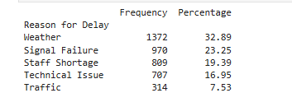
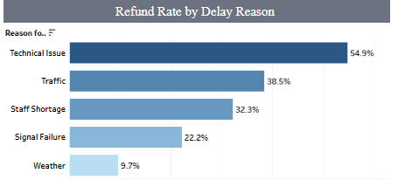
Operations Analysis
Disruptions, Refund Rates & Station Performance
1) Disruption Frequency ≠ Disruption Cost
Weather causes the most disruptions (32.9%) but only 9.7% of affected passengers request a refund — they accept it as uncontrollable. Technical Issues rank 4th in frequency but generate a 54.9% refund rate — passengers blame the company directly.

Slide 23
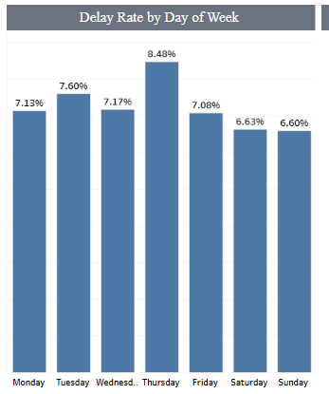
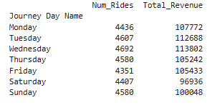
Operations Analysis
Disruptions, Refund Rates & Station Performance
2) When Do Delays Peak?
Wednesday has the highest ride volume (4,692 journeys). Thursday has the highest delay rate (8.48%). Operational pressure builds mid-week and manifests as delays the following day.

Slide 24
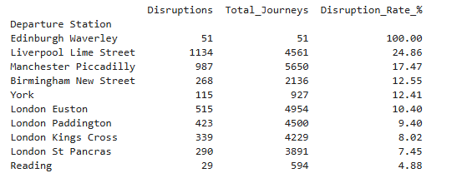
Operations Analysis
Disruptions, Refund Rates & Station Performance
3) Which Station Is Really the Worst?
Raw disruption counts from Python confirm Liverpool Lime Street is the true underperformer with 1,134 disruptions — higher than Manchester Piccadilly's 987. When normalized by total journeys, Liverpool's disruption rate reaches 24.9% — nearly 3x the network. average of 13.18%.

Slide 25
Insights & Recommendations
1) Technical Issues Are the Most Expensive Problem
Insight:
Weather causes the most disruptions (1,372 cases = 32.9%) — but passengers accept it as beyond the company's control, so only 9.7% request a refund.
Technical Issues happen far less often (707 cases = 17%) — but because passengers see this as the company's fault, 54.9% demand a refund.
This means Technical Issues — despite being 4th in frequency — are the #1 financial risk. Every Technical Issue disruption is nearly 6x more likely to cost the company money than a weather disruption.
Recommendations:
Prioritize preventative maintenance over addressing the effects of weather. Fixing problems that result in refunds will increase revenue.

Slide 26
Insights & Recommendations
2) Liverpool Lime Street Is the True Underperformer
Insight:
Liverpool Lime Street has the highest disruption rate when normalized — 1,134 disruptions across 4,561 journeys, resulting in a 24.9% disruption rate, nearly 3x the network average of 13.18%.
Recommendations:
Conduct an operational audit at Liverpool Lime Street, with a focus on Technical Issues — the leading cause of its disproportionately high 24.9% disruption rate.

Slide 27
Limitations
1 — Only 4 Months of Data:
Dataset covers Jan–Apr 2024 only — summer and winter seasonal patterns are not captured, limiting trend analysis and forecasting reliability.
2 — Refund Amount Is Unknown
The dataset records Refund Request as Yes/No only — no actual refund amounts are stored. The £38,702 figure assumes full ticket price was refunded in every case, which may overestimate actual losses.
3— Edinburgh Waverley Data Quality Issue
Edinburgh Waverley shows a 100% disruption rate (51 out of 51 journeys disrupted) — this is statistically impossible in reality and suggests a data collection issue for this station specifically.

Slide 28
Future Improvements
1 — Extend Dataset to 12+ Months
More data would capture yearly seasonality and improve trend analysis accuracy across all seasons.
2 — Investigate Edinburgh Waverley
A 100% disruption rate for Edinburgh Waverley needs investigation — either a data collection error or a genuine operational crisis that deserves attention.
3 — Add Actual Refund Amounts
Collecting real refund amounts (not just Yes/No) would enable accurate financial loss reporting and better ROI analysis for operational improvements.

Slide 29
Predictive Modeling
Journey Status Prediction
Goal: Predict whether a journey will be On Time, Delayed, or Cancelled.
31,653 journey records were used for model training and evaluation.
Key features included Price, Route, Journey Day, and Departure Hour.
Three classification models were tested and compared.
Journey Data
↓
Classification Models
↓
On Time | Delayed | Cancelled
31,653 Journey Records
3 Models Compared

Slide 30
Model Comparison & Selection
Decision Tree
Balanced Random Forest
88.44% Accuracy
Baseline model used for initial comparison.
89.92% Accuracy
Improved detection of Delayed and Cancelled journeys.
Random Forest
Final Selection
Cancelled Recall: 20% → 40%
91.30% Accuracy
Highest overall accuracy, but weaker on minority classes.
Balanced Random Forest
Selected for better minority-class detection, especially Cancelled journeys.

Slide 31

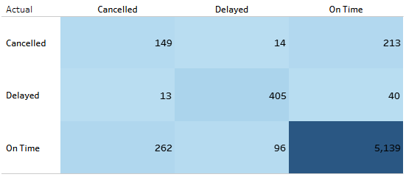
Final Model Evaluation
FinalModel Performance
The final Balanced Random Forest achieved strong overall performance while improving the detection of disrupted journeys.
Confusion Matrix
Prediction Results
Top Prediction Drivers
89.92%
Model Accuracy
5,693 Correct 638 Wrong
Price : 12.98%
Journey Day :12.81%
Route :12.66%
Departure Hour :12.45%
Journey Month :10.72%

Slide 32
Key Insights
77.3% of revenue comes from Full-Fare passengers.
Advance Tickets generate 41.7% of total revenue.
Technical Issues generate the highest refund rate at 54.9%.
Liverpool Lime Street has the highest normalized disruption rate at 19.7%.

Slide 33
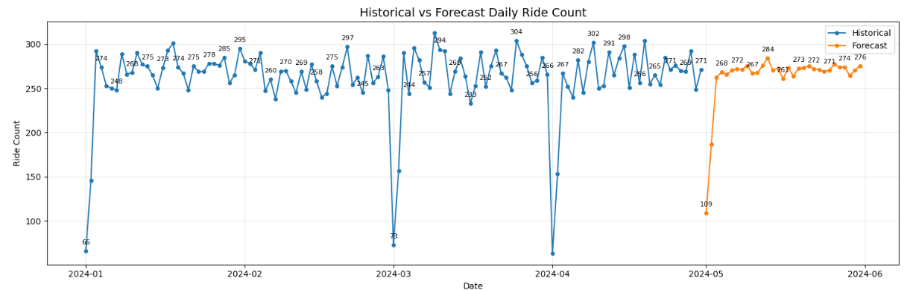
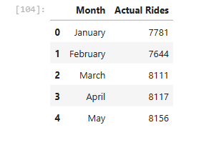
Forecasting
Forecast Daily Ride Count
Objective
Predict daily ride demand for May 2024.
Support operational planning and resource allocation.
Key Insights
Daily ride demand is expected to remain stable throughout May.
No significant drop in passenger demand is forecast.
Resources should be allocated based on the expected daily demand.

Slide 34
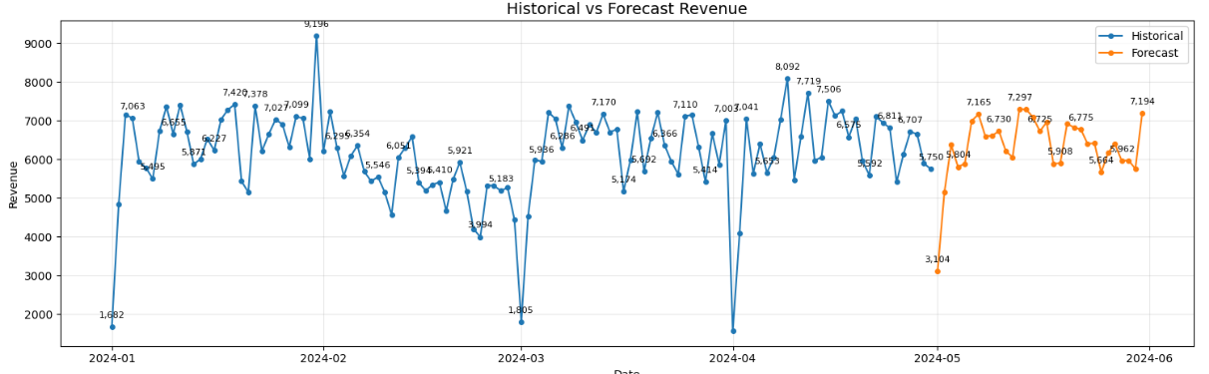
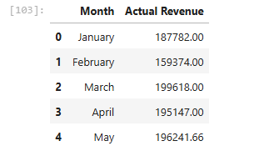
Forecasting
Forecast Daily Revenue
Objective
Predict daily revenue for May 2024.
Support financial planning.
Key Insights
Daily revenue is expected to remain relatively stable.
Revenue fluctuations follow the expected rides demand.
Financial planning can rely on the forecasted revenue trend.

Slide 35
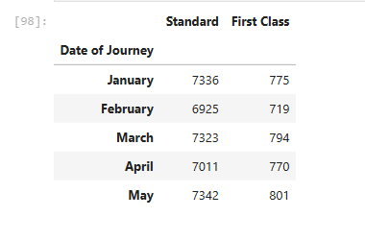
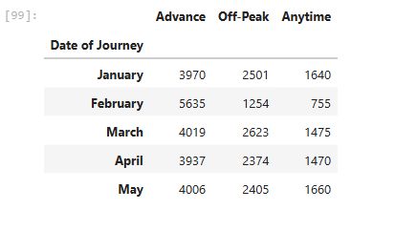
Forecasting
Forecast Ticket Class & Ticket Type Demand
Objective
Forecast future demand for ticket classes and ticket types.
Help optimize ticket allocation and pricing.
Key Insights
Standard Class is forecast to remain the most popular ticket class.
Advance tickets continue to have the highest demand.
Anytime tickets are expected to remain the least requested option.

Slide 36
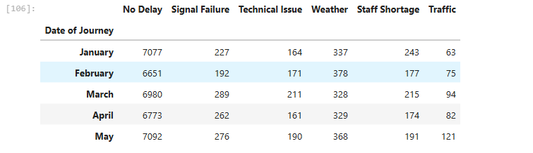
Forecasting
Forecast Delay Reasons
Objective
Predict the expected number of delays by reason for May 2024.
Help railway operators prepare for potential operational disruptions.
Key Insights
No Delay is expected to increase from 6,773 in April to 7,092 in May, indicating improved operational performance.
Signal Failure is forecast to increase slightly from 262 to 276, remaining a key operational issue.
Technical Issues are expected to rise from 161 to 190, requiring preventive maintenance.
Traffic Delays show the largest increase (82 → 121), suggesting additional traffic management may be needed.
Weather and Staff Shortage are expected to increase moderately and should continue to

Slide 37
Summary Table
Business Recommendations
Forecast Area | Key Finding
Daily Rides | The model predicts stable daily ride demand during May.
Revenue | Daily revenue is expected to remain stable with slight fluctuations.
Ticket Class | Standard Class remains the highest-demand ticket class.
Ticket Type | Advance tickets continue to have the highest demand.
Delay Reasons | Traffic and Technical Issues are expected to increase slightly.
Increase train capacity during high-demand periods.
Prioritize maintenance to reduce Signal Failures and Technical Issues.
Allocate more Standard Class and Advance tickets to match forecasted demand.
Monitor Traffic and Staff Shortage delays to minimize service disruptions.
Use forecasting results for resource allocation and financial planning.

Slide 38

YAT
DEPI
THANK YOU
Data is just numbers — until you ask the right questions
TableauDashboard: https://public.tableau.com/app/profile/kerols.raafat/viz/UK-RailwayAnalytics/OverviewDashboard?publish=yes
عمتا الدنيا فيها قمرين واحد في السما والتاني دكتور دينا ...
شكرا لحضرتك جدا يا دكتور وعلي تعب حضرتك معانا

